Slide 1
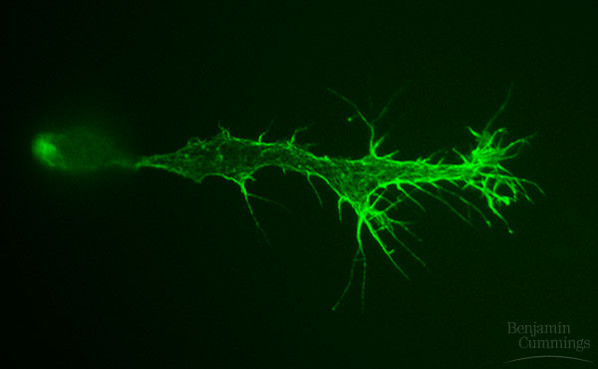
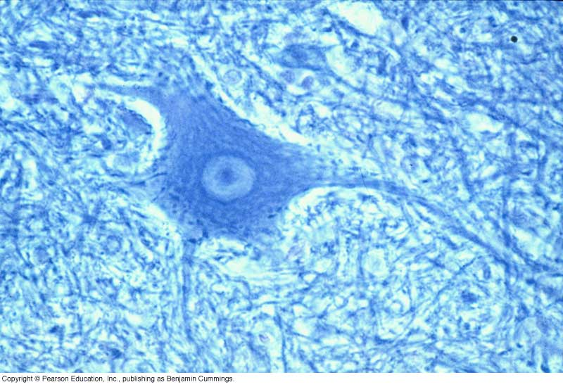
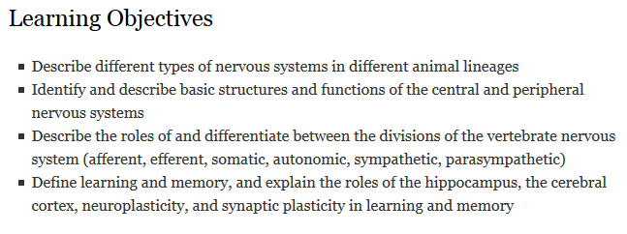
Nervous Systems
Notes:
The human brain Contains an estimated 100 billion nerve cells, or neurons
magnetic resonance imaging Is a technology that can reconstruct a three-dimensional map of brain activity
Day 2:
https://www.youtube.com/watch?v=zeo19WVQ47w
https://www.youtube.com/watch?v=owFnH01SD-s
https://www.youtube.com/watch?v=yLa-cXg8BwM

Slide 2
Key Concepts: The Vertebrate Nervous System
Nervous systems consist of:
circuits of neurons and supporting cells
Nerves are:
strands of nervous tissue containing (thousands of) axons wrapped in connective tissue
Most animals have a central nervous system (CNS) and a peripheral nervous system (PNS)
The central nervous system:
Receive signals from the PNS (afferent/sensory neurons)
Integrates incoming signals (interneurons)
Responds by sending signals back to the PNS (efferent/motor neurons)
The peripheral nervous system:
Receives sensory information and send to CNS (afferent/sensory neurons)
Receives signals from CNS and transmits to muscles, glands, etc (efferent/motor neurons)
Notes:
Neurons are cells that transmit electrical signals.
During an action potential, an inflow of sodium ions is followed by an outflow of potassium ions.
At synapses, the neurotransmitter causes a change in the receiving cell’s membrane potential.
Vertebrates have a central nervous system (CNS) and a peripheral nervous system (PNS).
They have a membrane potential, which is an electric potential, or voltage, due to differences in the concentrations of ions on the two sides of the plasma membrane.
Changes in membrane voltage are called action potentials.
An electrical signal from one neuron is converted to a chemical signal in the form of a neurotransmitter.
PNS neurons receive sensory information and transmit it to the CNS for processing. The CNS then sends signals to muscles, glands, or other target tissues via other PNS neurons.

Slide 3
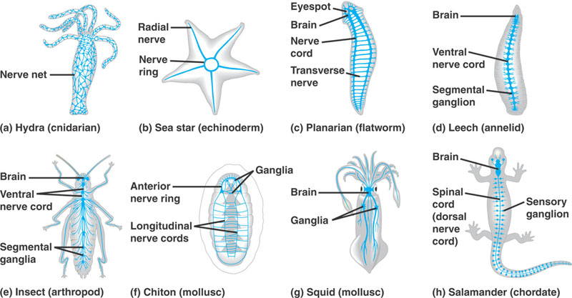
Diversity of nervous systems
All animals except sponges Have some type of nervous system.
Nervous systems range from simple nerve nets to more complex arrangements of a central nervous system (CNS) with peripheral neurons (PNS)
Figure 49.2, Campbell & Reece
Notes:
What distinguishes the nervous systems of different animal groups Is how the neurons are organized into circuits
What is a nervous system for?

Slide 4
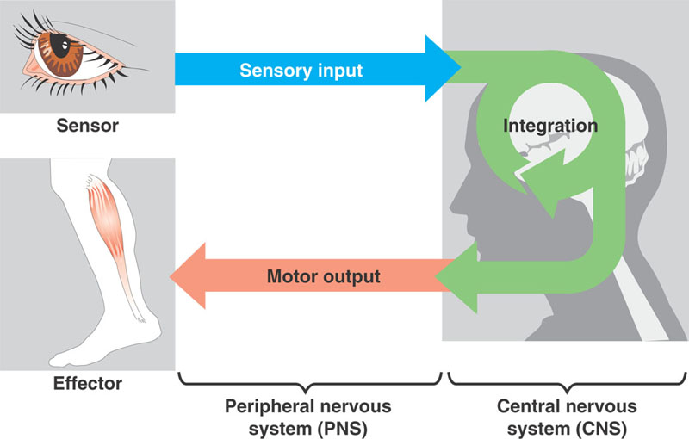
The nervous system processes information
3 stages: sensory input, integration, and motor output
Sensory neurons → interneurons→ motor neurons
Figure 48.3, Campbell & Reece

Slide 5
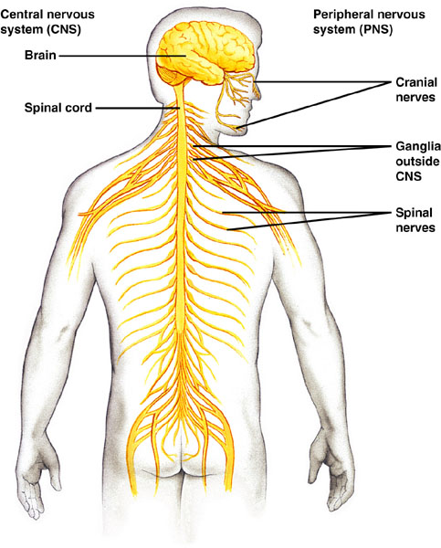
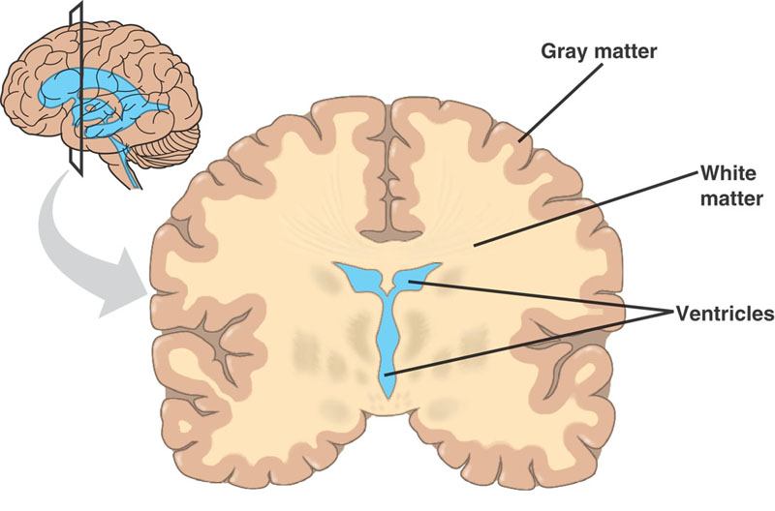
Specialization in the vertebrate nervous system
CNS: brain and spinal cord
PNS: cranial and spinal nerves
Ganglia: cluster of neuronal cell bodies
White matter: myelinated axons
Gray matter: unmyelinated axons and cell bodies
Campbell 8e 49.4,5
Notes:
The brain provides the integrative power that underlies the complex behavior of vertebrates
The spinal cord integrates simple responses to certain kinds of stimuli and conveys information to and from the brain
The central canal of the spinal cord and the four ventricles of the brain are hollow and fluid-filled, since they are derived from the dorsal embryonic nerve cord. Cerebrospinal fluid is generated by filtering arterial blood, it circulates and drains into veins.
The PNS transmits information to and from the CNS and plays a large role in regulating a vertebrate’s movement and internal environment
The cranial nerves originate in the brain and terminate mostly in organs of the head and upper body
The spinal nerves originate in the spinal cord and extend to parts of the body below the head
White matter vs grey matter distinguished by whether the axons are myelinated (white matter) or not. Grey matter also consists of neuron cell bodies.

Slide 6
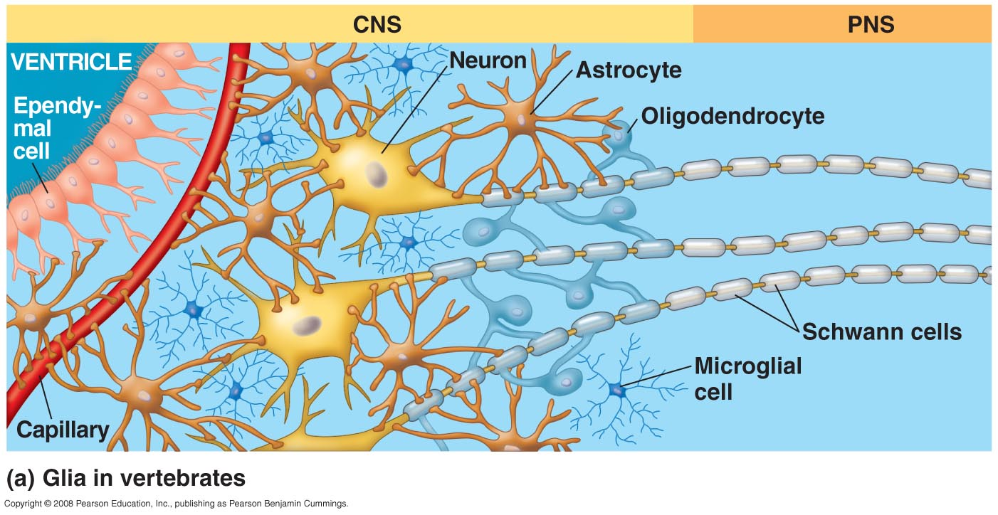
Anatomy of the brain
Ependymal cells: line the ventricles, cilia contribute to circulation of cerebrospinal fluid
Astrocytes: maintain extracellular fluid contents; facilitate increased blood flow to active neurons
Oligodendrocytes & Schwann cells: form myelin sheaths
Microglia: immune cells of the nervous system
Campbell 8e 49.6
The central canal of the spinal cord and the four ventricles of the brain are hollow and fluid-filled. Cerebrospinal fluid is generated by filtering arterial blood; it circulates and drains into veins.
White matter vs grey matter distinguished by whether the axons are myelinated (white matter) or not. Grey matter also consists of neuron cell bodies. Gray matter represents information processing centers in the brain, and white matter represents the networking of (connections between) these processing centers
Notes:
The brain provides the integrative power that underlies the complex behavior of vertebrates
The spinal cord integrates simple responses to certain kinds of stimuli and conveys information to and from the brain
The central canal of the spinal cord and the four ventricles of the brain are hollow and fluid-filled, since they are derived from the dorsal embryonic nerve cord. Cerebralspinal fluid is generated by filtering arterial blood, it circulates and drains into veins.
The PNS transmits information to and from the CNS and plays a large role in regulating a vertebrate’s movement and internal environment
The cranial nerves originate in the brain and terminate mostly in organs of the head and upper body
The spinal nerves originate in the spinal cord and extend to parts of the body below the head
White matter vs grey matter (more later in this lecture) distinguished by whether the axons are myelinated (white matter) or not. Grey matter also consists of neuron cell bodies.

Slide 7
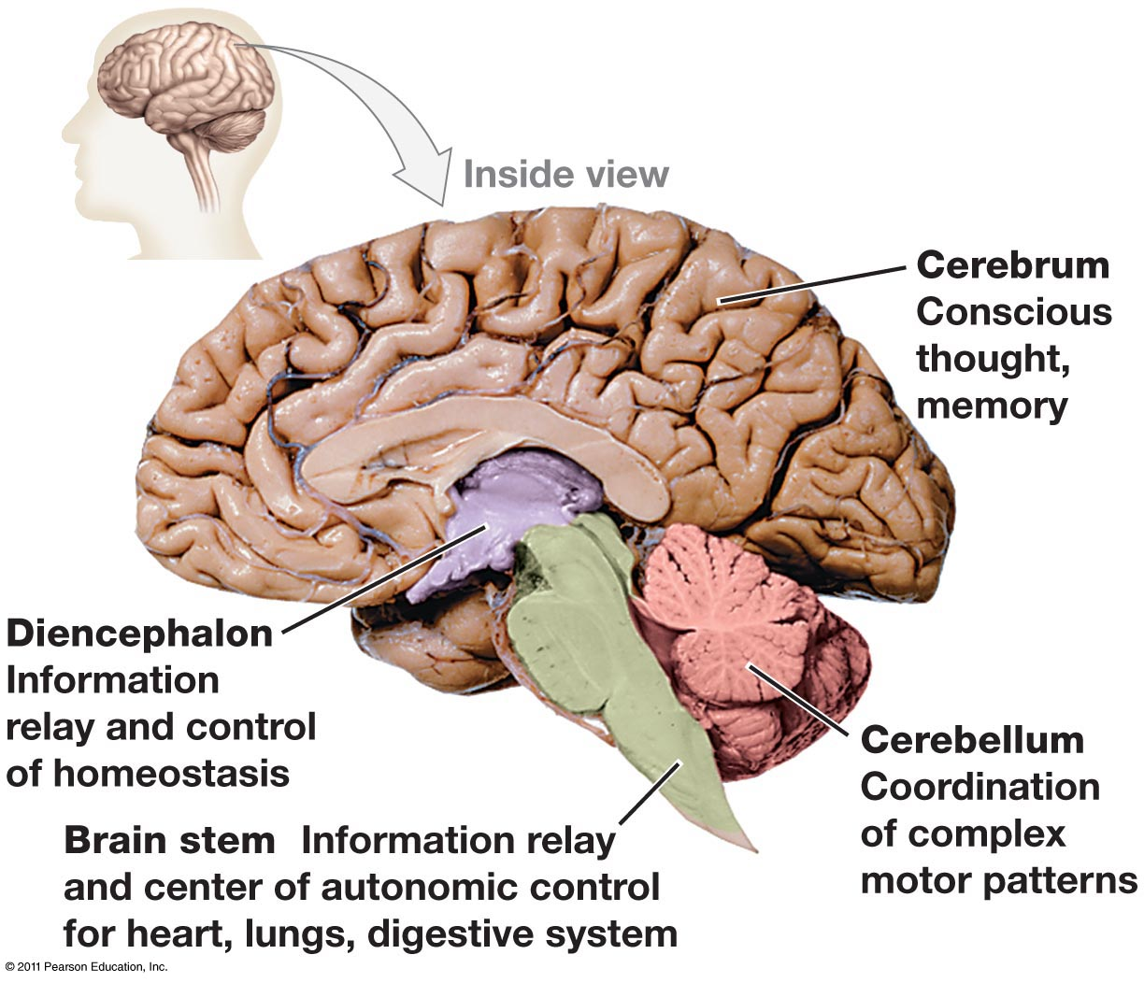
General anatomy of the brain
What brain structure is located here (hint: homeostasis is controlled here)?
What type of nerves originate here?
Freeman 4e 45.17
Notes:
Hypothalamus is located in diencephalon
Cranial nerves originate from the brainstem
All other nerves originate from the spinal cord

Slide 8
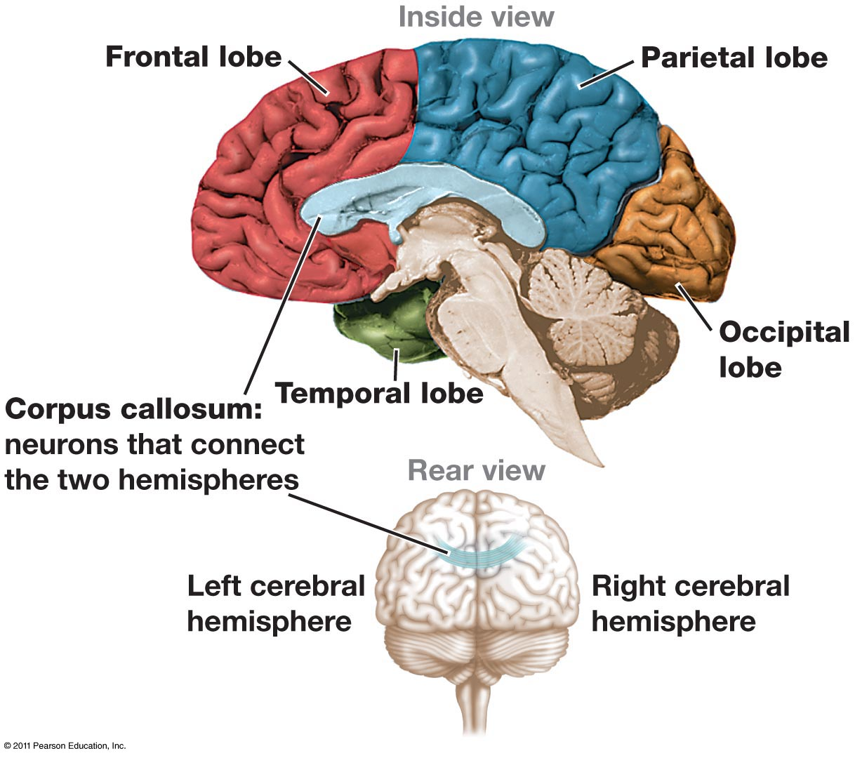
The cerebral lobes
Sense of touch and sensory integration
Decision making, planning, forming speech, skeletal muscle control
Hearing & comprehending language;
memory formation and storage
Vision processing, pattern recognition, visual associations
Freeman 4e 45.18
Notes:
Different functions map to different physical locations within the brain
Evolution of human brain during mammalian evolution – primarily expansion of association areas – sensory areas are largely same size; rat cerebral cortex = mostly primary sensory areas; human cerebral cortex has a lot of association areas integrating information from various parts of brain = complex behavior and learning

Slide 9
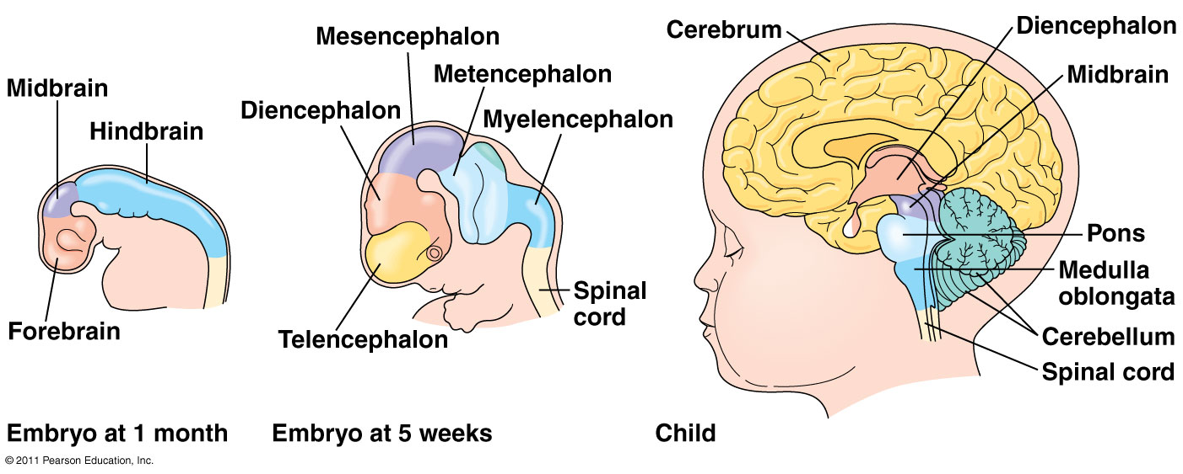
Development of the mature neuron network
Figure 49.9 Campbell & Reece.
By the end of embryogenesis,
Half of embryonic neurons undergo programmed cell death
Half of initial synapses are lost
This basic architecture is then continually remodeled in a process known as neural plasticity
Campbell 8e 49.9
Notes:
Neural plasticity = capacity for ns to be remodeled, esp in response to its own activity

Slide 10
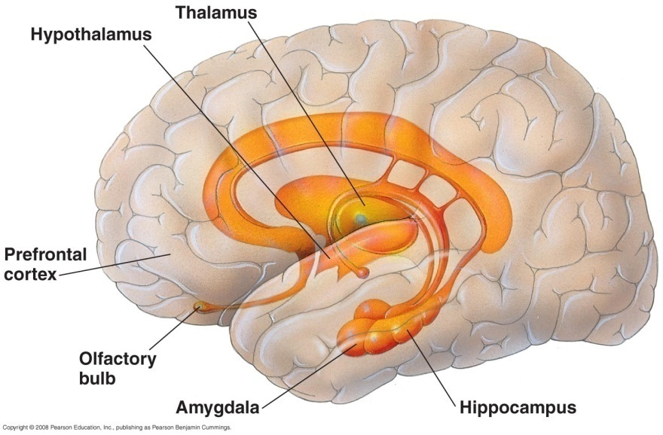
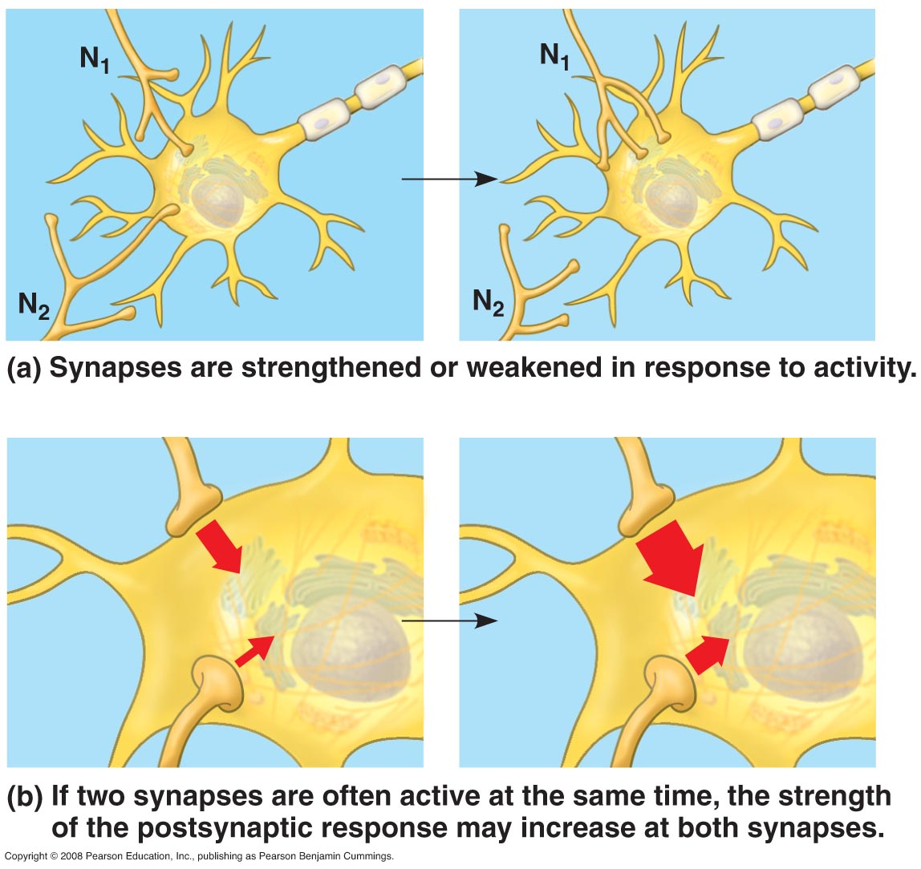
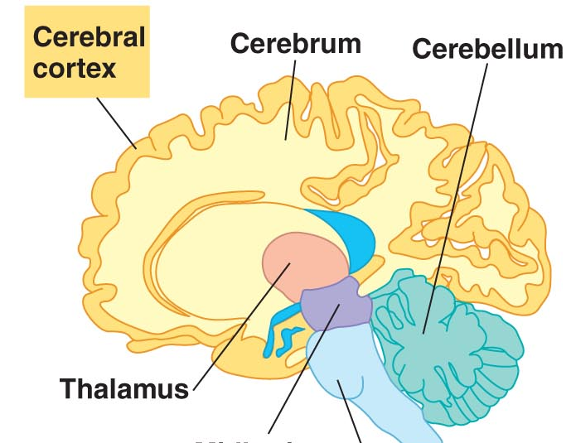
Neural plasticity is fundamental to learning/memory
Learning/memory mediated by:
Addition or destruction of synapses
Strengthening (potentiation) or weakening (depression) of post-synaptic response
Hippocampus mediates consolidation of short term memory to long term memory (short term memories are stored in cerebral cortex and accessed via prefrontal cortex)
Figure 49.19 Campbell & Reece.
Potentiation: strengthening of a synapse
Sensitization: increased response to a stimulus
Depression: weakening of a synapse
Habituation: decreased response to stimulus that has been repeated without an important effect
Current hypothesis:
Memories are stored in specific neurons (within cerebral cortex).
Chemical and structural changes in synapses mediate learning and memory.
Cerebral cortex mediates access to long term memory (info also stored in cerebral cortex)
Notes:
Remodeling and refinement underlie learning and memory
Learning = enduring, adaptive change in behavior that results from a specific experience
Memory = retention of learned information
Short term = lost if it becomes irrelevant
Long term = stored, returned to short term memory when needed
Both types of info stored in cerebral cortex
Short term = info accessed by links in hippocampus (in temporal lobe)
Long term = info accessed by links within cerebral cortex
Hippocampus = essential for creating new long-term memories, but not for maintaining them

Slide 11
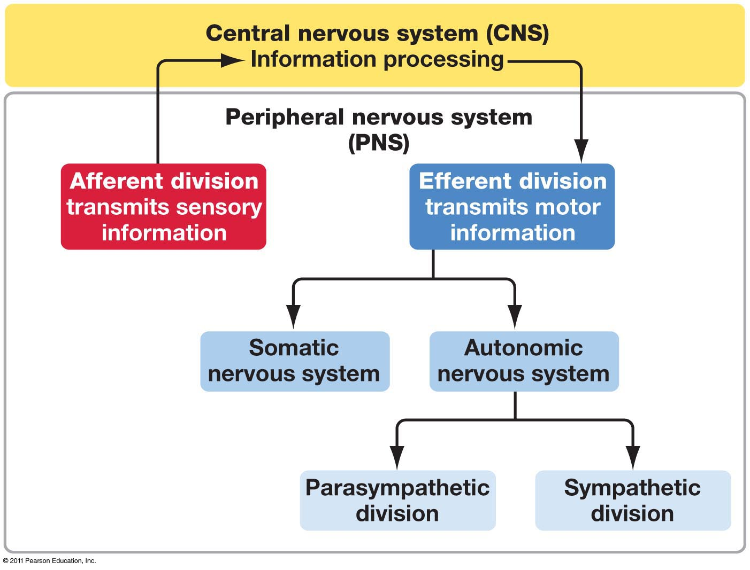
The Vertebrate Nervous System
Information input
Reaction
Voluntary muscle movements
Involuntary muscle movements
“rest and digest”
“fight or flight”
Freeman 4e 45.15
Notes:
Where is the CNS? Where are the different divisions of the PNS?

Slide 12
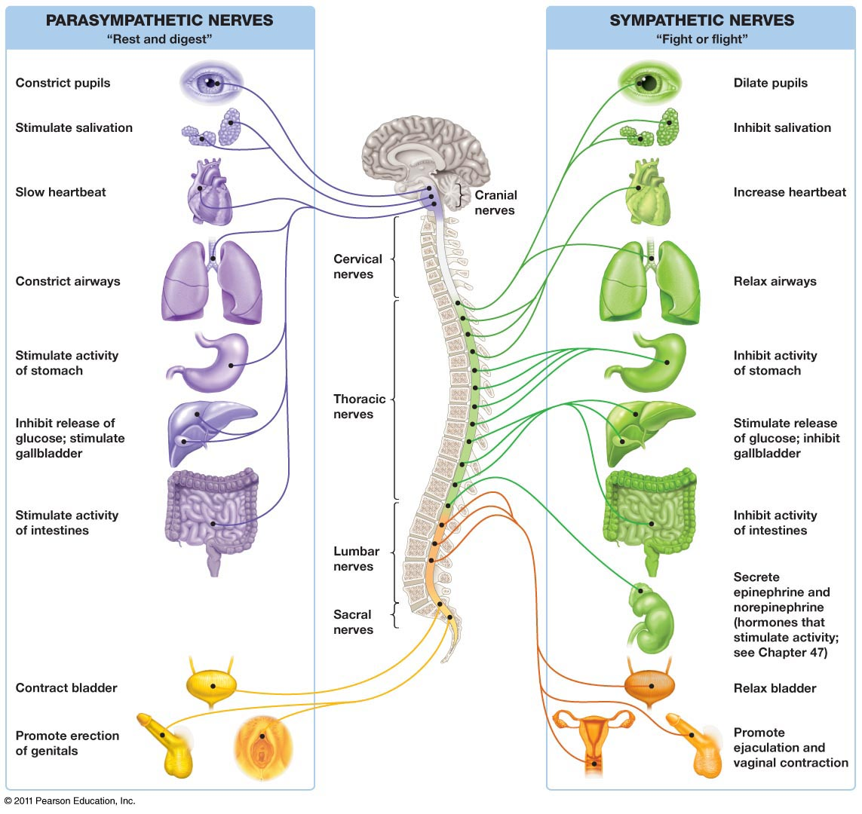
Freeman 4e 45.16
Notes:
Physical origins of nerves in autonomic nervous system
Act in opposition in all regards except sexual function

Slide 13
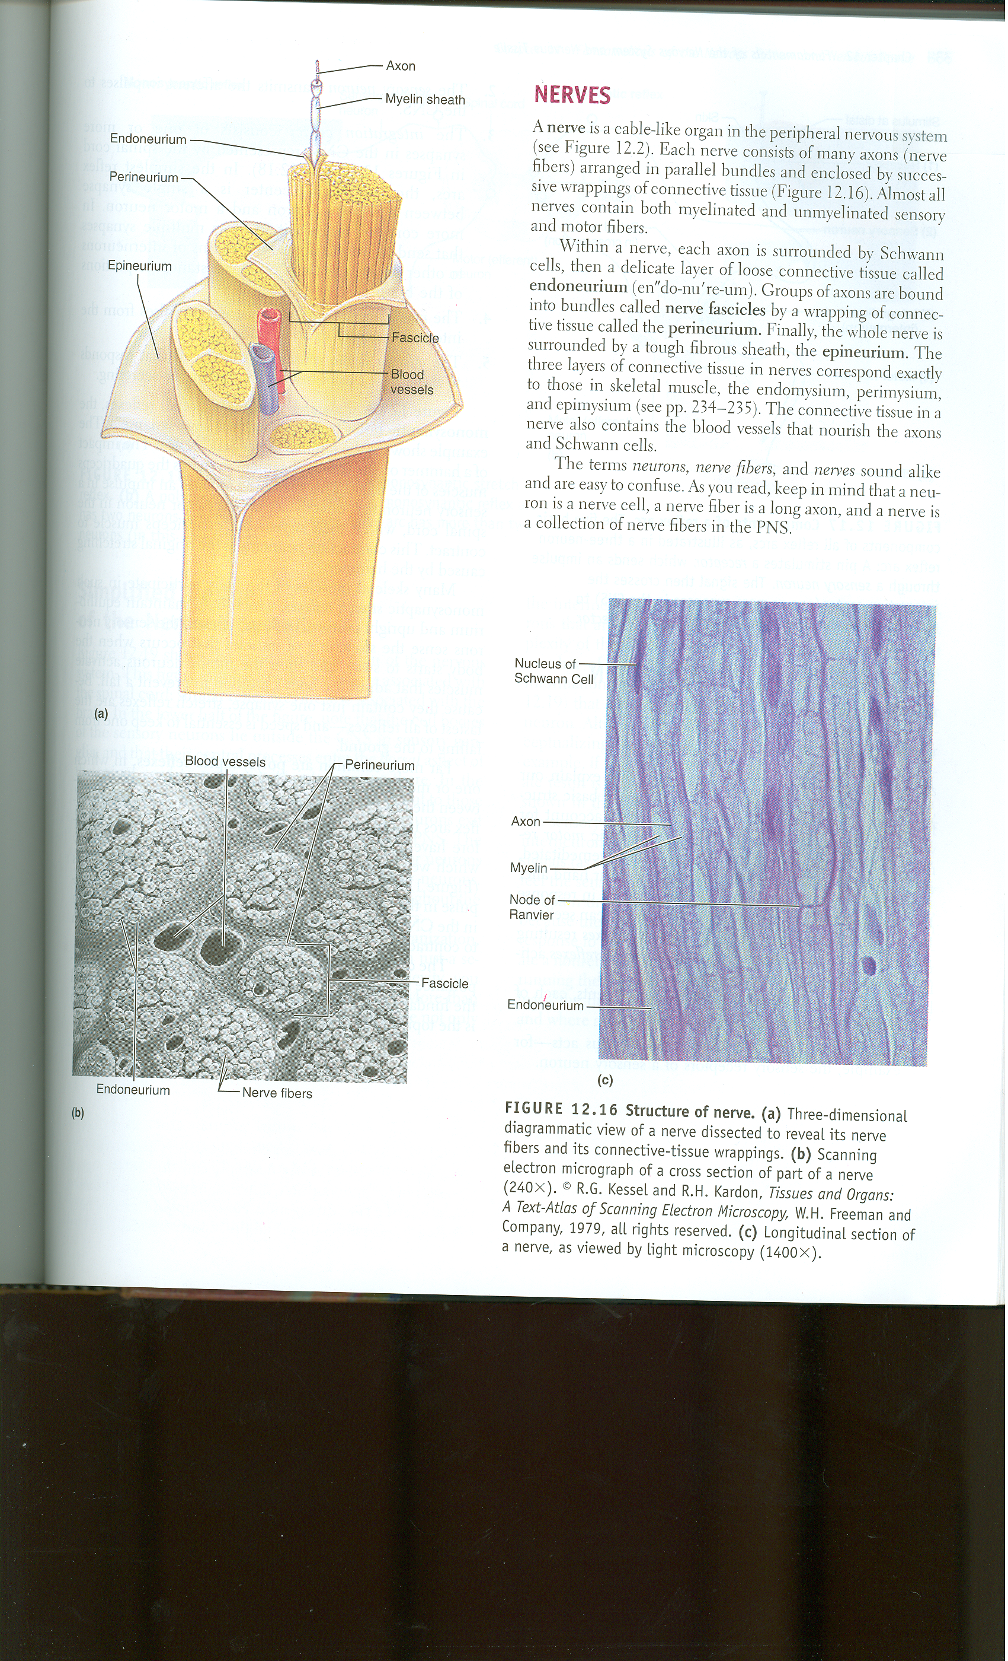
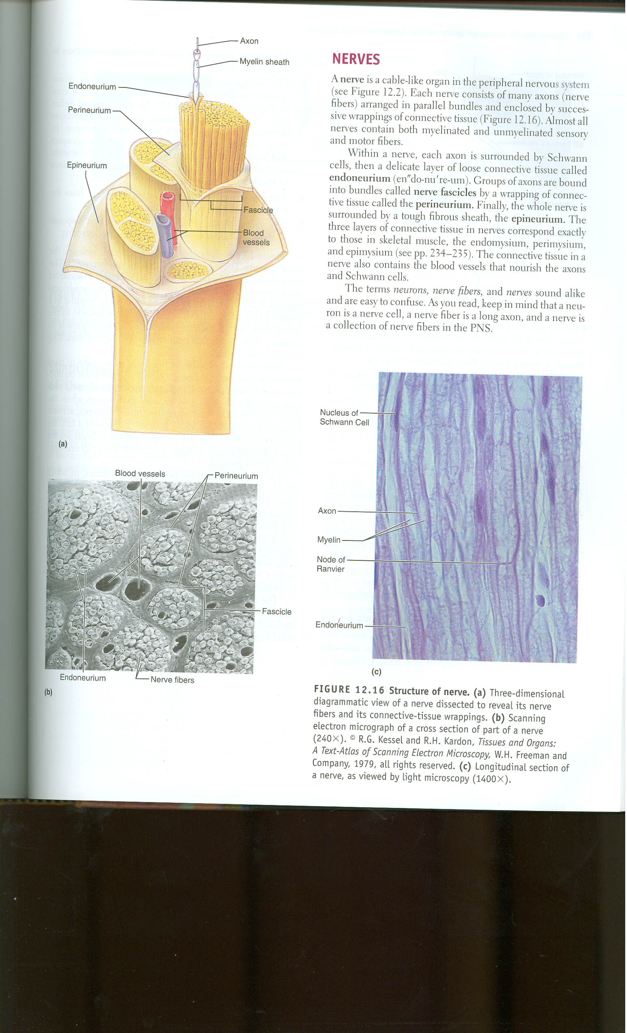
Anatomy of a nerve?
Nerve ≠ neuron
Nerve = bundles of neurons + supporting tissues:
Three layers of tissue
Axons bundled in fascicles
Blood vessels
Figures 12.16 Marieb et al. 2005. Human Anatomy
Notes:
Each axon encased in delicate layer of connective tissue, groups of axons bundled as nerve fascicles are wrapped in conn tissue, entire nerve wrapped by tough fibrous sheath.
What is tissue called that binds/supports other cells? Connective tissue= a few sparse cells in extracellular matrix

Slide 14
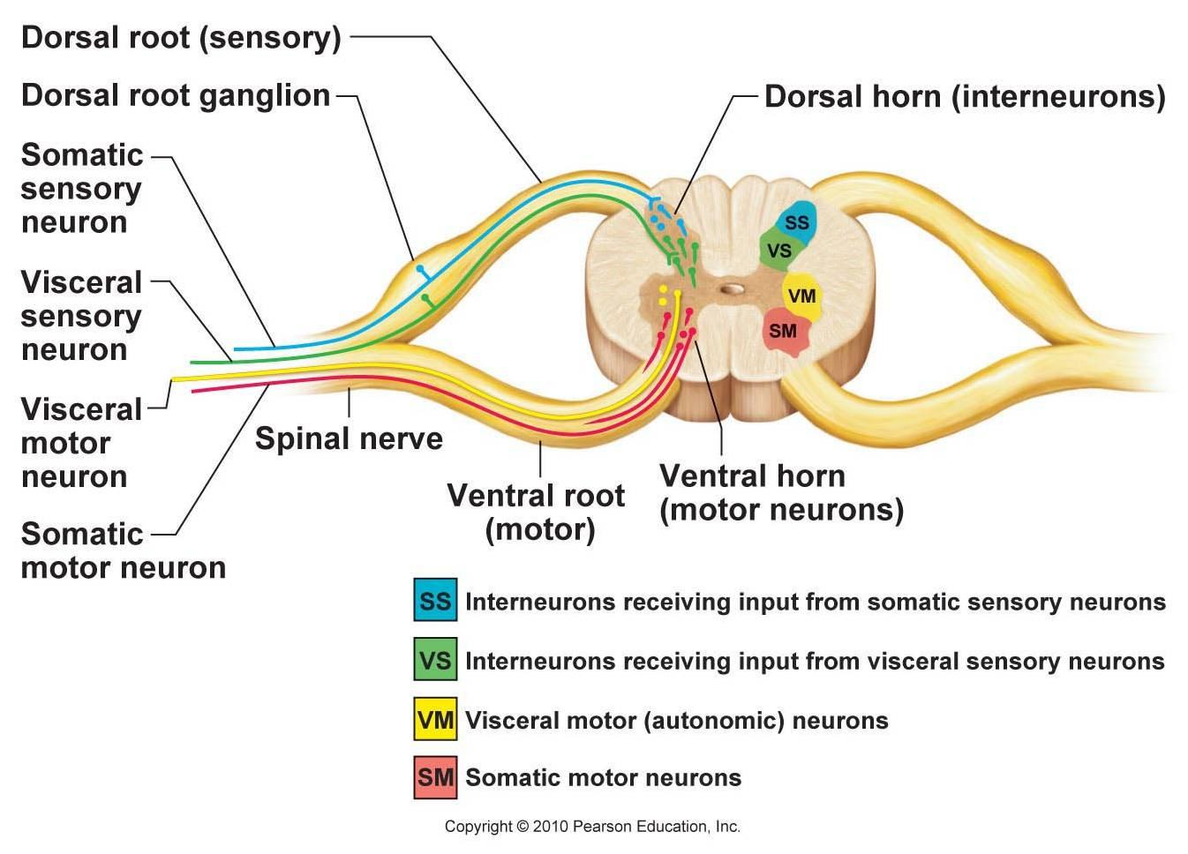
Anatomy of the spinal cord
In the spinal cord vs the brain:
Where is the white matter?
Where is the gray matter?
Figure 13.32 Marieb et al. 2005. Human Anatomy
Notes:
Cerebrospinal fluid circulates throughout central (spinal) canal and brain ventricles; function in exchange and transport, and in protection
Visceral = autonomic
Ganglion = cell bodies
Nerve has sensory/effector somatic and visceral neurons together – split such that sensory comes in at dorsal side, effector exits at ventral side. Interneurons in between
PNS is all sensory or effector neurons
CNS is interneurons – neither sensory nor effector (in brain interneuron specifies short neurons that make connections btwn others)

Slide 15
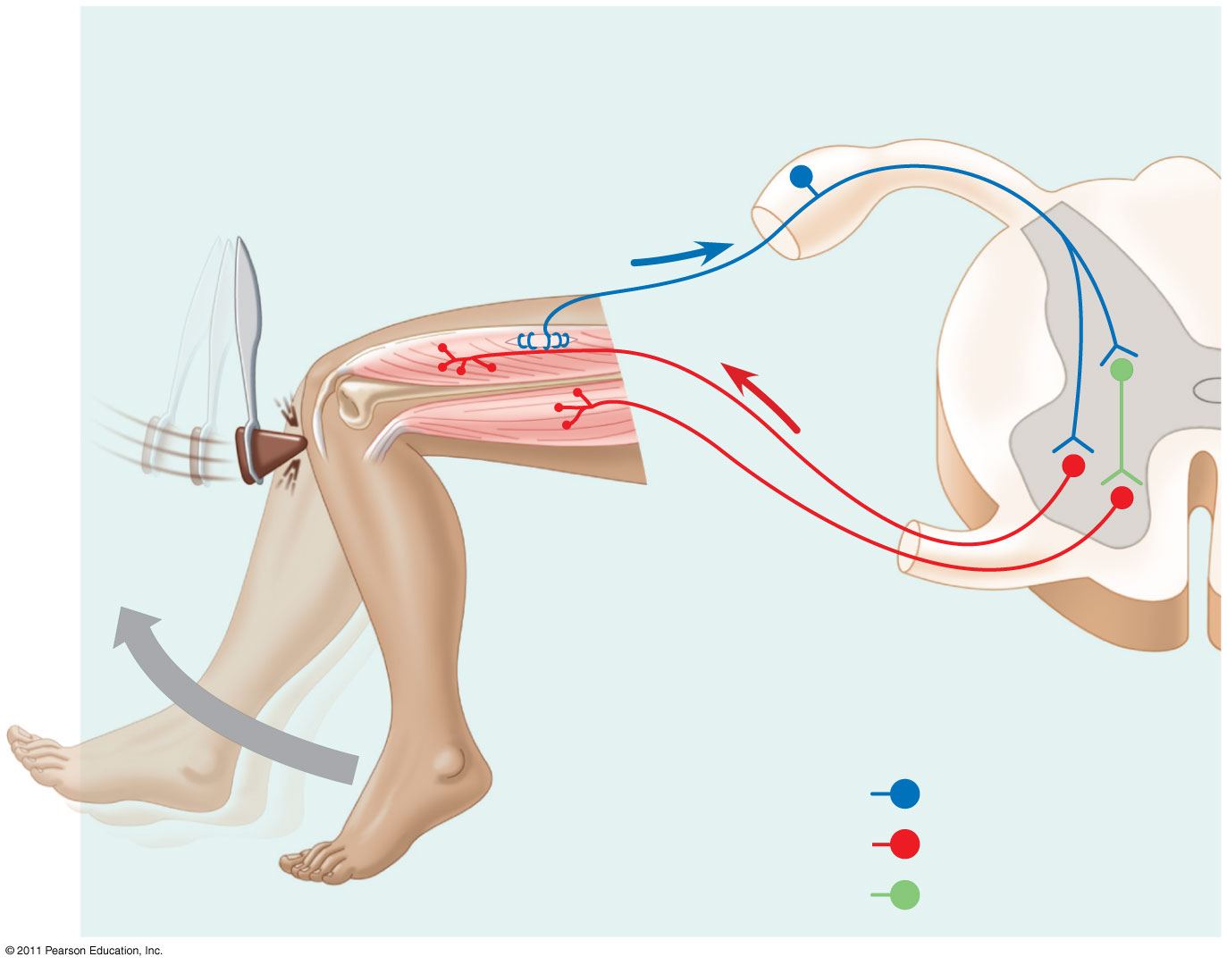
Integrating the CNS and PNS
What molecular process is happening where the neurons meet?
Cell body of sensory neuron in dorsal root ganglion
Quadriceps muscle
Gray matter
White matter
Hamstring muscle
Spinal cord (cross section)
Sensory neuron
Motor neuron
Interneuron
Campbell 8e 49.3
Notes:
Reflex example – limited to loop
“Columns” of white matter connect brain and spinal cord
Molecular process = nt release – either excitatory or inhibitory post synaptic potentials

Slide 16
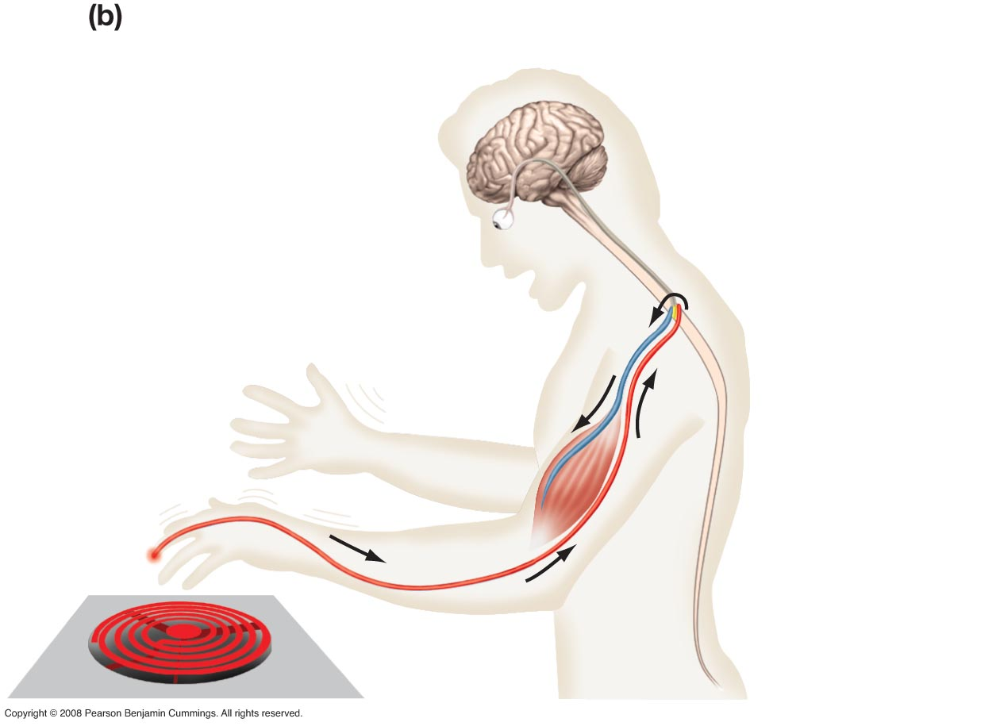
Simple example: reflex arc How can you tell the stove was hot as opposed to sharp or soft?
Label each node
What happened at each node?
Trace the signal pathway
7
6
3
4
1
5
2
Freeman 2e 45.1

